Slide 1
Lyme Disease and Ticks
Customizable Sample Training PowerPoint for School Health Educators

Slide 2
How to Use This Presentation
This presentation contains the functional knowledge related to ticks and tick-borne disease prevention including Lyme Disease.
The information provided may be copied, used and/or distributed without fee for educational purposes. Any reproduction, use, and/or distribution should credit the New York State Center for School Health. Permission to copy, use and/or distribute materials as described above shall not extend to information that is credited to other sources. Reproducing materials for profit and/or any commercial use is strictly forbidden without express prior written permission of the New York State Center for School Health. Individuals or districts choosing to use the this presentation are solely responsible for the content and any modifications made.
URLs for resources can be found in the notes section.
A blank slide is included for you to add additional information.
This slide should be deleted prior to use.

Slide 3
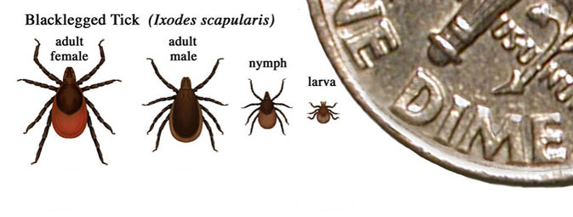
What is a Tick?
Ticks are bugs that bite people and animals
They come in different sizes. Some ticks are very small - about the. size of a poppy seed
A tick feeds on the blood of warm blooded animals, like humans, and transmits bacteria in their saliva.
When a person or an animal is bitten by an infected tick, the tick’s saliva transmits the bacteria causing illness.
Infections from tick-borne diseases have been increasing in NYS and in the US.
Notes:
Image CDC Stop Ticks https://www.join.me/ 2/15/18

Slide 4
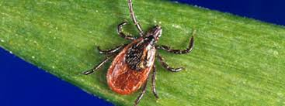
What is a Tick-Borne Disease
A Tick-Borne disease is spread by the bite of a tick.
Not all ticks can cause disease and not all bites make you sick.
It's important to learn how to prevent a bite, how to remove a tick and what to do if you think you could have a tick-borne disease.
Lyme disease is the most common disease spread by ticks in New York state but there are other serious diseases which are also spread by ticks.
Notes:
NYSDOH Lyme Diseases and Other Diseases Carried by Ticks
Source: https://www.health.ny.gov/diseases/communicable/lyme/ 2/15/18
Image CDC Stop Ticks https://www.join.me/ 2/15/18

Slide 5
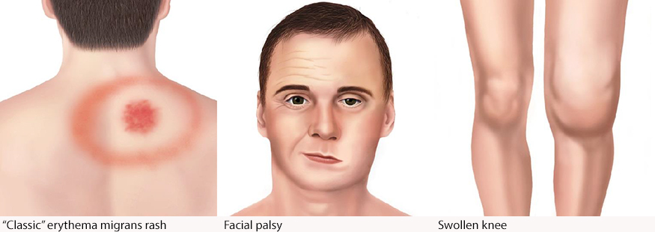
Signs of Lyme Disease
A rash may appear 3-14 days after a tick bite. Not all rashes are from Lyme disease.
Many people do not get the rash so it's important to watch for signs/symptoms of early Lyme disease including flu-like symptoms, headache, etc. Some people have a local reaction to the tick bite-like redness or swelling.
You may or may have all of them. If you notice any of them after you have removed a tick, you should see your medical provider.
It is important to see your health care provider to see if you have Lyme Disease and get the proper medicine.
Notes:
Photo Source: https://www.cdc.gov/lyme/signs_symptoms/index.html 3/7/2018

Slide 6
How Common is Lyme Disease
According to the Centers for Disease Control and Prevention (CDC), many people do not know they are at risk each year for tick borne illness.
Each year more than 30,000 cases of Lyme disease are reported nationwide. Studies suggest the actual number of people diagnosed with Lyme disease is more likely about 300,000.
Notes:
CDC Lyme and other Tick-borne Diseases https://www.cdc.gov/media/dpk/diseases-and-conditions/lyme-disease/index.html 2/16/18

Slide 7
How to Avoid Ticks
Wear light-colored clothing so you can easily see any ticks and remove them before they can attach
Tuck your pants into your socks.
Check for ticks on clothing or skin every few hours and at the end of the day. Prompt removal of attached ticks will reduce the risk of tick-borne disease.
Stay on cleared, well-traveled trails. Avoid dense woods and bushy areas.
Avoid sitting directly on the ground or on stone walls.
Take a shower as soon as possible after going outdoors to wash off and look for ticks that may be on you.
Check your pets for ticks when they come in from being outdoors.
Clean the clothes you wore outside. Non-washable gear (backpacks etc.) can placed in a hot dryer for 10 minutes, which will kill any ticks that are on them.
Use EPA registered insect repellent according to the label. You should ask your parents or another adult to help you to make sure you do it safely.
Notes:
NYSDOH Lyme Disease Fact Sheet https://www.health.ny.gov/diseases/communicable/lyme/ 3/5/18

Slide 8
Slide intentionally left blank for educators to add information about local tick related information

Slide 9
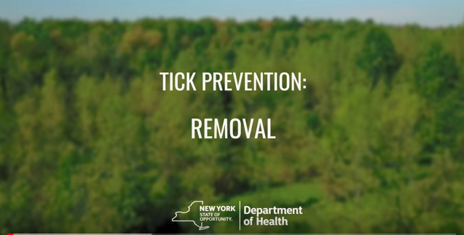

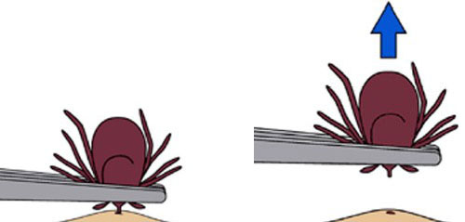
How To Remove A Tick If You Find One
Use fine-tipped tweezers to grasp near the head and pull upward
Grasp tick as close to the skin as possible
Do not squeeze the belly of the tick
Click on the picture to watch a video on tick removal from the
New York State Department of Health
Notes:
NYSDOH How to Remove a Tick Video located at https://youtu.be/oGrK4ZKUfhQ
New York State Health Department Video on Tick removal. Sourced 3/2018
Image: CDC https://www.cdc.gov/ticks/removing_a_tick.html 2/15/18

Slide 10
After You Remove A Tick
Be sure to tell an adult or your doctor about your recent tick bite, when the bite occurred, and where you most likely acquired the tick.
Save the tick to show the doctor if needed.
Watch for signs of illness - which might feel like the flu or a rash somewhere on your body and let an adult or your doctor know.
Notes:
https://youtu.be/oGrK4ZKUfhQ
New York State Health Department Video on Tick removal. Sourced 3/2018
Image: CDC https://www.cdc.gov/ticks/removing_a_tick.html 2/15/18

